Slide 1

PBIS

Slide 2


What is PBIS?
Positive
Behavior
Intervention
Support
a positive behavior management process to create safer and more effective schools.
a system of clear schoolwide expectations with consequences and incentives.
intervention when you need help.
recognition and celebration for students’ successes!
This plan was adopted by our district to help improve our students’ social, emotional, and academic success by setting up positive strategies for defining, teaching, and supporting appropriate student behaviors to create a positive school environment.

Slide 3

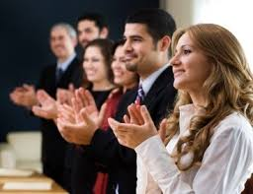

What does PBIS do for you?
Students are recognized and praised for positive behaviors.
  gifts, opportunities to participate in special events, etc...
Students receive interventions to help them refocus their unsuccessful behaviors.
  teacher-student conference, parent contact, reflections, parent conference, administrative referral.

Slide 4
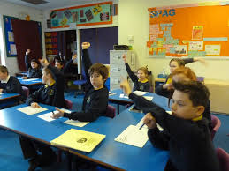
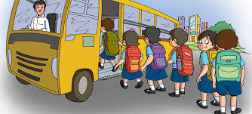
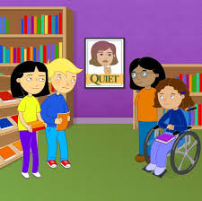
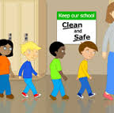
How does PBIS work?
All students follow the same set of rules and expectations throughout all areas in the building.
These rules and expectations are displayed on posters in every hallway and classroom.
When students follow the rules and expectations, they are recognized.
        When students do not follow the rules, there are planned consequences to help them get back on track.

Slide 11

Remember!
The Tiger says, “Be Respectful! Be Responsible! Be Safe! Be Caring”
Mt. Pleasant Jr. High PBIS Expectations Matrix
 | Classroom | Cafeteria | Bathrooms | Hallways | Buses | Library/ Computer Lab | School Grounds
Respect | -Follow directions -Raise your hand -Use appropriate language -Use appropriate tone -Keep your hands & feet to yourself -Be on time -Have materials and be ready to work | -Follow directions -Listen to adults -Exhibit good table manners -Keep food on your plate or in your mouth -Keep food in cafeteria -No cutting in line -Clean up after yourself | -Respect the privacy of others -Keep the facilities clean | -Keep hands & feet to yourself -Observe personal space of others -Listen to adults in hallway -Use your quiet inside voice -Go straight to your destination and be on time | -Follow directions -Walk to your bus -Wait patiently until your bus stops to get on -Listen to the bus driver -Stay seated at all times -Use appropriate language -Keep it clean | -Follow directions -Use your quiet inside voice -Raise your hand to be recognized | -Follow adult directions -Use appropriate language -Obey all drill procedures (fire, weather, crisis)
Responsibility | -Employ active listening -Participate actively -Do your work -Turn homework in on time complete | -Stay in designated area -Clean up your eating area | - Do your business & leave -Flush the toilet -Throw trash in appropriate receptacles - Wash hands -Don’t use it as a hang out | -Carry a valid hall pass -Go straight to your destination --Pick up litter | -Stay seated while the bus is moving -Keep your body and belongings inside the bus | -Follow Media Center & Computer Lab Rules -Use equipment correctly -Access only appropriate websites | -Dispose of trash in appropriate receptacles -Use equipment correctly
Safety | -Keep your hands & feet to yourself | -Wait in line for your turn -Keep your hands & feet to yourself | -Report problems, vandalism, etc | -Walk on the right -Keep hands & feet to yourself | -Enter and exit in an orderly fashion -Stay in your seat -Report any incidents | -Enter and exit in an orderly fashion -Stay in your seat -Report any incidents | -Use equipment correctly -Keep hands & feet to yourself

Slide 12
How can you be recognized?
When consistent, students will be recognized for appropriate behaviors such as:
      Helping other students in class
      Help pick up trash you see on the floor
      Cleaning up messes in the cafeteria
      Turning in (to the office) any item that you find that does not belong to you.
      Completing work on time and being responsible for your grades.
      Anything that may stand out as going out of their way to be good.

Slide 13
Incentives
Tiger Tickets will be used again this year.
We will give ALL of your teachers a group of Tiger Tickets to begin the year. If you are recognized by any teacher or staff member for something outstanding, they will turn in a ticket with your name. This ticket will then be placed in a drawing for a chance to win a prize.
If you are a WINNER:
You will be able to choose a prize from the prize room.
The teacher that nominated you, will also be a winner.
These drawings will take place on Fridays during the morning announcements.
During 2nd or 4th period someone will come get you and take you to the prize room to choose your prize and take pictures with the staff member that “Caught you being good”.

Slide 14
Here is what a Tiger Ticket looks like.

Slide 15
Prize Room
Last year you could choose from a variety of prizes: basketballs, soccer balls, movie tickets, and more…
This year you will have to be “Caught being good” for your chance to visit the prize room.
We will be doing our best to restock our prize room for the year.

Slide 16
Student Recognition
After drawings, the rest of the tickets are turned into the office where our awesome principal, Kelli Glenn, takes the time to call you in to give you your ticket and let you know who acknowledged your “good deed”.
For our winners, we have a website where their picture along with the teacher who wrote the ticket will be displayed. We also hope to add the pictures to our big TV screens this year.

Slide 17
Website
For our winners, we have a website where their picture along with the teacher who wrote the ticket will be displayed. We also hope to add the pictures to our big TV screens this year.
This website not only posts our winners, but also lets you know who the team is, the expectation, and lesson plan.
Here is the link:
https://sites.google.com/site/mpjhpbis/

